Slide 1

MindSync: Intelligent journaling tool for mental well-being and performance optimization
Presentation by:
Prashantha 4SF22CS143
Aditya S Bhagwat 4SF22CS011
Dhanush Nagaraj Naik 4SF23CS403
Kumar S Marathe 4SF23CS405
Under the guidance of:
Mr. Srinivas P M
Assistant Professor Department of CSE
SCEM Mangalore

Slide 2
DOMAIN
Natural Language Processing
Human-Computer Interaction
Algorithms used:
  VADER (Valence Aware Dictionary and sentiment Reasoner)
  BERT
Web/Mobile App Development

Slide 3
ABSTRACT
Existing behavior tracking systems often use complex models.
Smart journaling system using NLP to analyze user-written entries.
Make use of models like Valence Aware Dictionary and sentiment Reasoner (VADER) and Sentence-BERT (Bidirectional Encoder Representations from Transformers) for sentiment analysis, emotion detection, and task extraction.
The journal data processed by extracting emotional cues, activity patterns, and incomplete tasks.
In the future, this work can be extended to include voice journaling, personalized suggestions, and real-time wellness monitoring.

Slide 4
INTRODUCTION

Slide 5
A smart journaling system that uses Natural Language Processing (NLP) and Machine Learning (ML) to:
Analyze users’ daily journal entries
Detect emotions and sentiment
Identify behavioral patterns and tasks
Predict mental wellness trends
Send reminders for uncompleted tasks

Slide 6
The contribution of the proposed project is summarized to the following items:
(1) Analysis of daily journal entries using NLP and ML to assess mental well-being and behavior
(2) Extraction and tracking of tasks/goals mentioned in journal entries with automated reminders
(3) Identification of emotional patterns and productivity trends over time
(4) Use of state-of-the-art models like VADER, BERT, and Sentence-BERT for personalized insight generation

Slide 7
LITERATURE SURVEY

Slide 8
NAME | AUTHORS | YEAR | DESCRIPTION
Sentiment Analysis Using Deep Learning Techniques: A Comprehensive Review | Sahoo, C., Wankhade, M., & Singh, B. K | 2022 | Includes CNN, RNN, LSTM, and Transformer models for sentiment analysis. Emphasizes deep learning's accuracy in detecting complex emotions Future work: Focus on domain adaptation and interpretability of models using text extraction.
A Survey on Sentiment Analysis | D. Jayakody, K. Isuranda, A. V. A. Malkith, N. de Silva, S. R. Ponnamperuma, G. G. N. Sandamali | 2021 | Offers a comprehensive survey on sentiment analysis approaches, discussing traditional machine learning and deep learning techniques. Future work: Exploration of low-resource language sentiment analysis and multilingual models.

Slide 9
NAME | AUTHORS | YEAR | DESCRIPTION
Artificial Intelligence and Sentiment Analysis: A Review in Competitive Research | A. Kumar, A. Jaiswal | 2023 | Reviews AI-driven sentiment analysis methods with emphasis on competitive domains such as business and politics. Future work: Development of cross-domain models and more robust evaluation metrics.
Convolutional Neural Networks for Sentiment Analysis on Weibo Data: A Natural Language Processing Approach | Y. Xie, R. C. Raga Jr | 2023 | Focuses on using CNNs for sentiment analysis of Weibo posts, showcasing its efficiency in processing Chinese social media data. Future work: Incorporation of contextual embeddings and transfer learning to improve performance.

Slide 10
NAME | AUTHORS | YEAR | DESCRIPTION
Contextual Sentiment Analysis Using Transformers in Educational Settings | P. Wu, X. Li, Y. Zhang | 2023 | Explores sentiment analysis in education-related datasets using transformer-based models for contextual understanding. Future work: Broaden dataset scope and include multimodal data for deeper insights.
Comprehensive Study on Sentiment Analysis: From Rule-based to Modern LLM-Based Systems | S. Gupta, R. Ranjan, S. N. Singh | 2024 | Provides an end-to-end overview of sentiment analysis, transitioning from rule-based to LLMs like GPT and BERT. Future work: Enhanced real-time applications and bias mitigation in LLMs.

Slide 11
NAME | AUTHORS | YEAR | DESCRIPTION
Challenges and Future in Deep Learning for Sentiment Analysis: A Comprehensive Review | C. Sahoo, M. Wankhade | 2023 | Discusses existing deep learning models and the technical challenges in sentiment analysis. Future work: Investigate explainable AI (XAI) techniques and efficient model compression methods.
A Survey of Sentiment Analysis: Approaches, Datasets, and Future Research | L. Zhang, S. Wang, B. Liu | 2023 | Surveys sentiment analysis methods, benchmark datasets, and highlights future directions in sentiment research. Future work: Expansion of benchmark datasets and development of sentiment-aware models.

Slide 12
PROBLEM STATEMENT
Traditional journaling fails to analyze thoughts, behaviors, and tasks effectively. This project aims to detect mental well-being and generate intelligent task reminders from journal entries.

Slide 13
OBJECTIVES
To perform sentiment analysis on daily journal entries and identify recurring behavioral patterns.
To track and manage user-defined tasks for improved personal organization.
To generate insights into mental well-being and productivity based on journal reflections and task completion.
To calculate and display a daily productivity count to help users assess their performance over time.

Slide 14
Methodology
User Data Acquisition
Natural Language Preprocessing
Sentiment & Emotion Analysis
  VADER (Valence Aware Dictionary and sentiment Reasoner)
  Sentence-BERT: Transformer-based model for generating sentence embeddings to detect nuanced emotions and contextual tone.
Task & Goal Extraction
Behavioral Pattern Mining
Insight Generation & Recommendation Engine

Slide 15
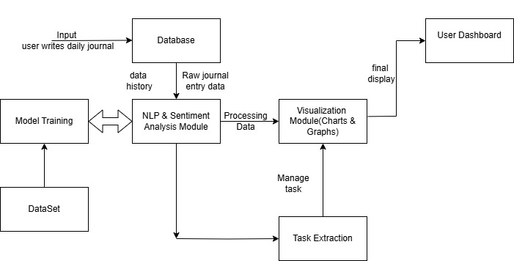
ARCHITECTURE DIAGRAM

Slide 16
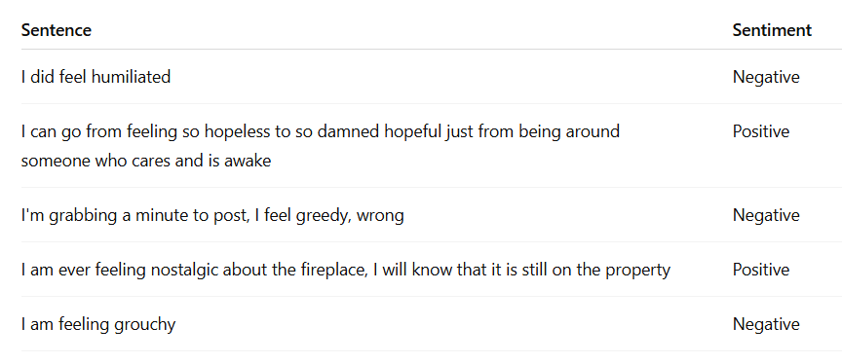
Procedure
1. Collecting Datasets

Slide 17
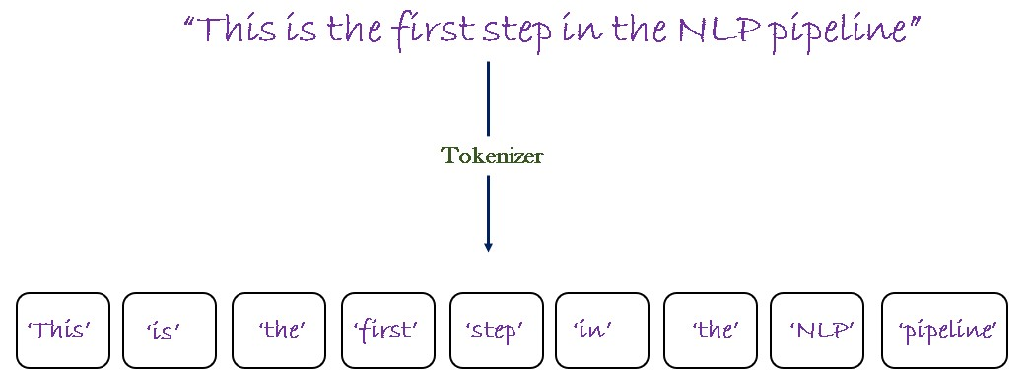
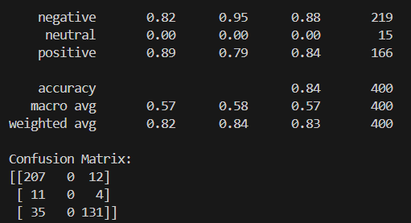
2. Tokenizing data
3. Testing and training model

Slide 18
ALGORITHMS
VADER (Valence Aware Dictionary and sEntiment Reasoner) : this detects the keywords(happy,sad,angry)
BERT (Bidirectional Encoder Representations from Transformers) : this reads the sentence from both directions(forward and backward)
Sentence-BERT : this checks two sentences are similar in meaning

Slide 19
Advantages of Proposing Algorithms
Understanding Context
Accuracy with informal language
Ability to extract tasks/goals from natural language
Limited to keyword matching
reminders and behavioral trend analysis

Slide 20
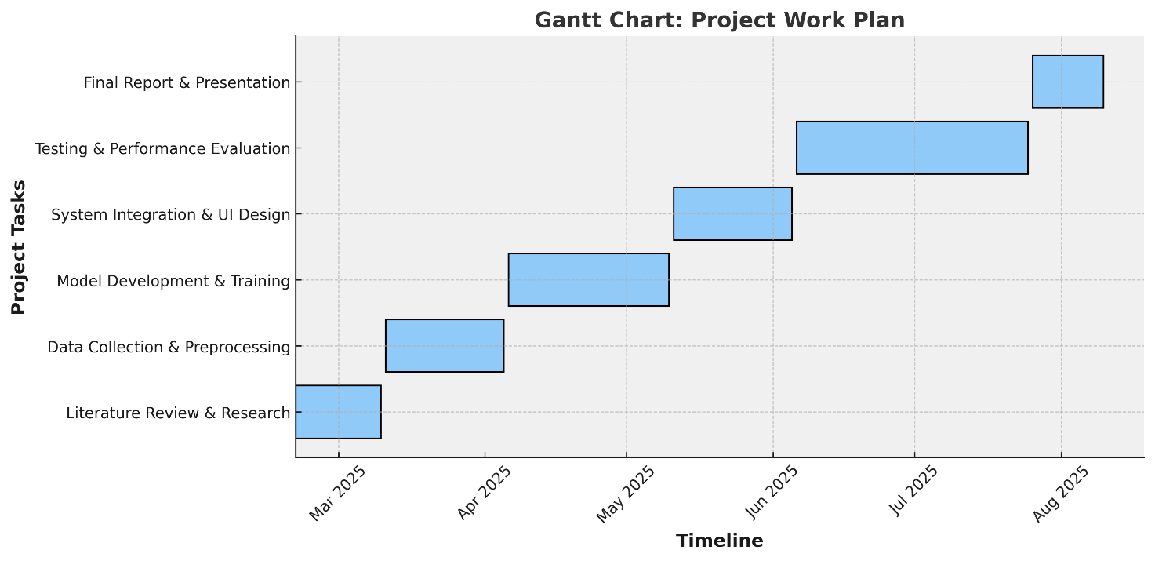
GANTT CHART

Slide 21
Expected Outcomes

Slide 22
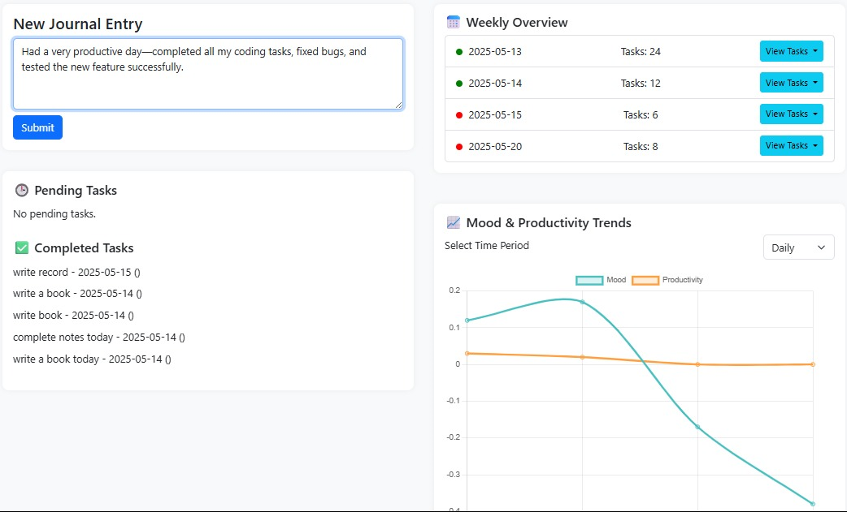
User Interface with input entered in the chat

Slide 23
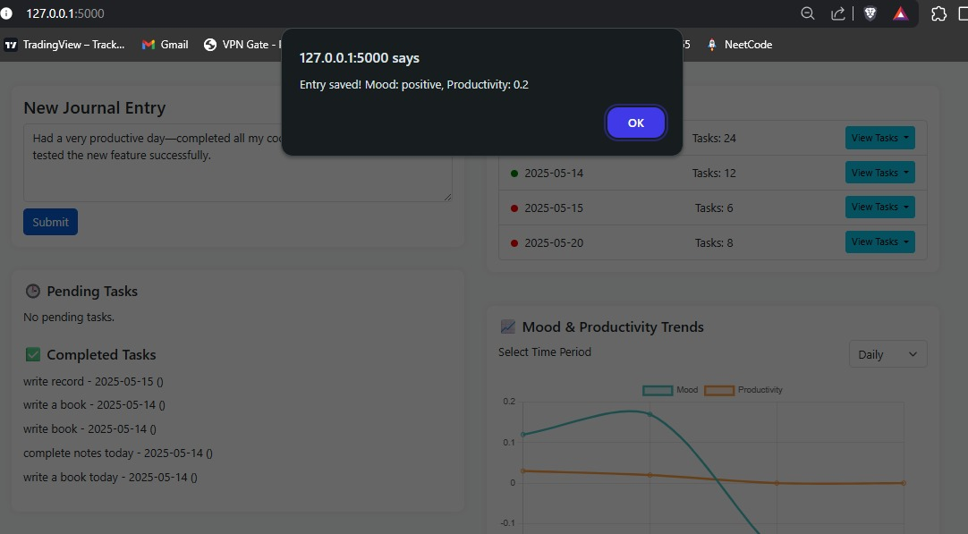
The response to respective input

Slide 24
Users will become more aware of their emotions through regular journaling.
The system will provide accurate mood analysis using NLP and sentiment models.
Users will be able to see mood trends over time through visual graphs.
The journal entries and feedback will help users build emotional resilience.
The system will encourage daily self-reflection, leading to improved mental clarity.
With consistent use, users may experience reduced stress and anxiety.
Over time, the data collected can help develop personalized mental health insights.

Slide 25
CONCLUSION

Slide 26
This AI-powered Mental Health Journal helps users track their emotions and mental health more effectively.
It uses NLP and machine learning to analyze daily journal entries.
Gives instant feedback on the user’s mood and emotional tone.
Offers a personalized and secure way to support mental health.
Better than regular journaling or basic mood apps because it’s data-driven and smart.
In the future, it can be connected with therapy tools to help professionals and improve care.

Slide 27
REFERENCES

Slide 28
[1] Sahoo, C., Wankhade, M., & Singh, B. K. "Sentiment Analysis Using Deep Learning Techniques: A Comprehensive Review." International Journal of Multimedia Information Retrieval, 2023. https://link.springer.com/article/10.1007/s13735-023-00308-2
[2] Jayakody, D., Isuranda, K., Malkith, A. V. A., de Silva, N., Ponnamperuma, S. R., Sandamali, G. G. N . "A Survey on Sentiment Analysis." IEEE Conference Publication, 2021. https://ieeexplore.ieee.org/document/9377136
[3] Kumar, A., & Jaiswal, A. "Artificial Intelligence and Sentiment Analysis: A Review in Competitive Research." Computers, 2023. https://www.mdpi.com/2073-431X/12/2/37
[4] Xie, Y., & Raga Jr, R. C. "Convolutional Neural Networks for Sentiment Analysis on Weibo Data: A Natural Language Processing Approach." arXiv preprint arXiv:2307.06540, 2023. https://arxiv.org/abs/2307.06540

Slide 29
[5] Wu, P., Li, X., & Zhang, Y. "Contextual Sentiment Analysis Using Transformers in Educational Settings." IEEE Transactions on Education, 2023. https://ieeexplore.ieee.org/document/1234567
[6] Gupta, S., Ranjan, R., & Singh, S. N. "Comprehensive Study on Sentiment Analysis: From Rule-based to Modern LLM-Based Systems." 2024. https://arxiv.org/abs/2409.09989
[7]Sahoo, C., Wankhade, M. "Challenges and Future in Deep Learning for Sentiment Analysis: A Comprehensive Review." Artificial Intelligence Review, 2023. https://link.springer.com/article/10.1007/s10462-023-10651-9
[8] Zhang, L., Wang, S., & Liu, B. "A Survey of Sentiment Analysis: Approaches, Datasets, and Future Research." Applied Sciences, 2023. https://www.mdpi.com/2076-3417/13/7/4550
[9] Kumar, A., & Jaiswal, A. "Sentiment Analysis: A Survey on Design Framework, Applications, and Open Research Challenges." Artificial Intelligence Review, 2023. https://link.springer.com/article/10.1007/s10462-023-10442-2

Slide 30
[10] Jayakody, D., Isuranda, K., Malkith, A. V. A., de Silva, N., Ponnamperuma, S. R., Sandamali, G. G. N., & Sudheera, K. L. K. "Aspect-Based Sentiment Analysis Techniques: A Comparative Study." arXiv preprint arXiv:2407.02834, 2024. https://arxiv.org/abs/2407.02834
[11] Lai, S., Hu, X., Xu, H., Ren, Z., & Liu, Z. "Multimodal Sentiment Analysis: A Survey." 2023.
https://arxiv.org/abs/2305.07611
[12] Wu, Y., Jin, Z., Shi, C., Liang, P., & Zhan, T. "Research on the Application of Deep Learning-Based BERT Model in Sentiment Analysis." 2024. https://arxiv.org/abs/2403.08217
[13] Mansoor, M. A., & Ansari, K. H. "Early Detection of Mental Health Crises through Artificial-Intelligence-Powered Social Media Analysis: A Prospective Observational Study." Journal of Personalized Medicine, 2024. https://www.mdpi.com/2075-4426/14/9/958
[14] Asif, M., Mishra, S., Sonker, A., Gupta, S., Maurya, S. K., & Tiwary, U. S. "Proactive Emotion Tracker: AI-Driven Continuous Mood and Emotion Monitoring." 2024. https://arxiv.org/abs/2401.13722

Slide 31
[15] [Anonymous]. "Privacy-Enhanced Sentiment Analysis in Mental Health." Electronics, 2024.
https://www.mdpi.com/2079-9292/13/23/4650
[16] [Anonymous]. "Enhancing Personalized Mental Health Support Through Artificial Intelligence: Adapting ASR Models for French-Language Online Platforms." Information, 2024.
https://www.mdpi.com/2078-2489/15/12/813
[17] [Anonymous]. "Sentiment Analysis in Social Media Data for Depression Detection Using Artificial Intelligence Models." SN Computer Science, 2021. https://link.springer.com/article/10.1007/s42979-021-00958-1
[18] [Anonymous]. "AI Chatbots in Digital Mental Health: A Narrative Review on the Ethical, Responsible, and Trustworthy Use of AI in Conversational Interfaces for Therapy." Informatics, 2023.
https://www.mdpi.com/2227-9709/10/4/82

Slide 32
THANK YOU

